Slide 1
2nd hand sports equipment

Slide 2

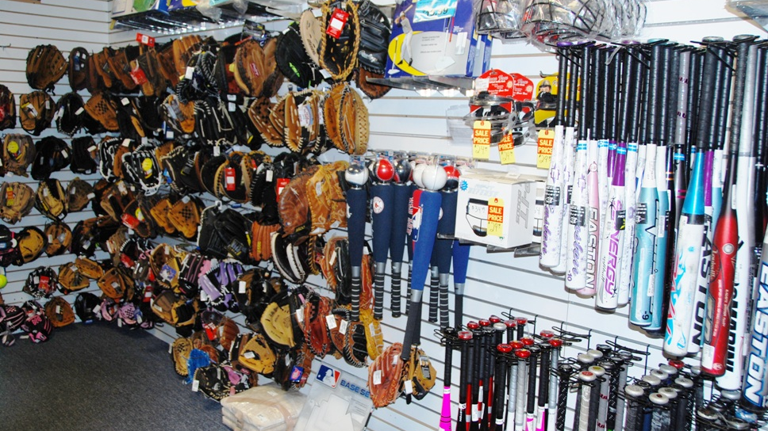

Slide 3
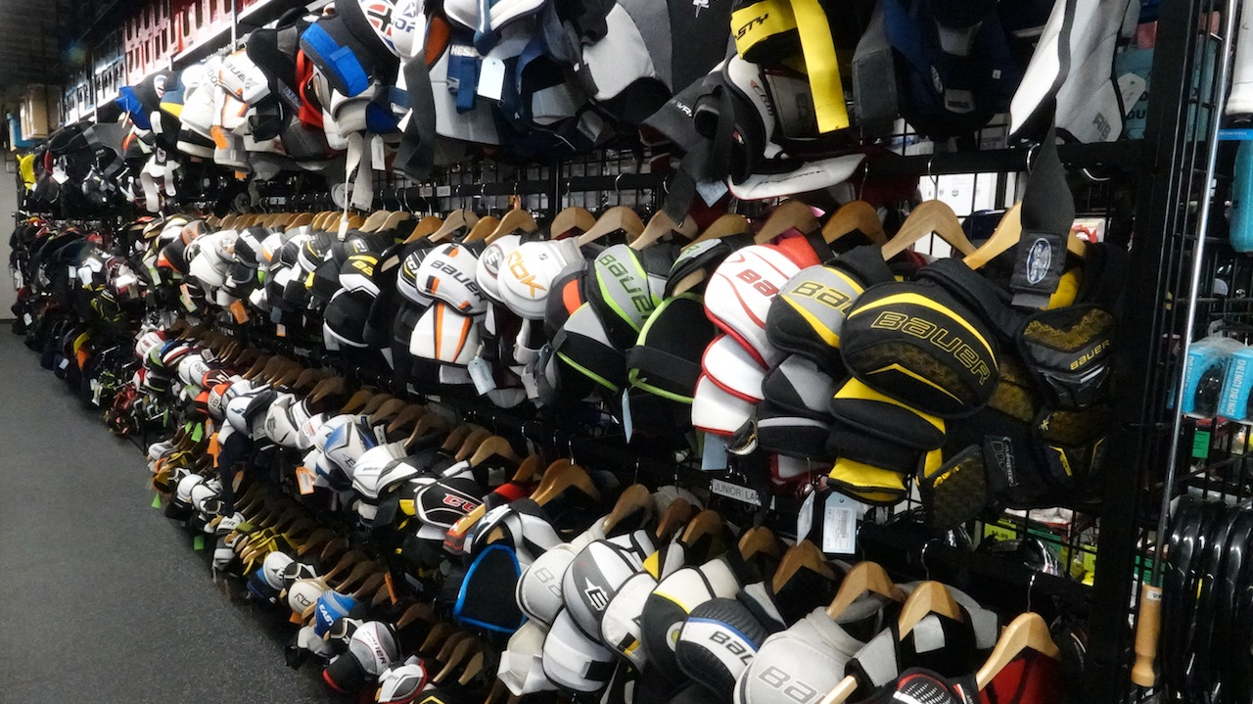

Slide 4
How we’ve helped
We’ve helped so many families change their kids lives
We offer a chance for kids to play sports at an affordable price
Everything is under $100

Slide 5
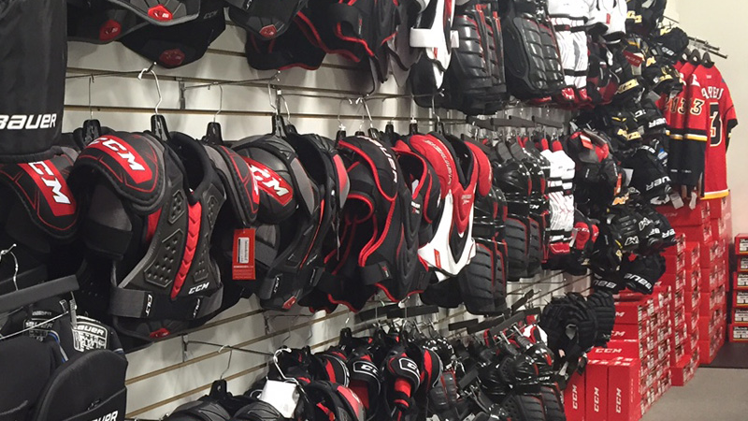

Slide 6
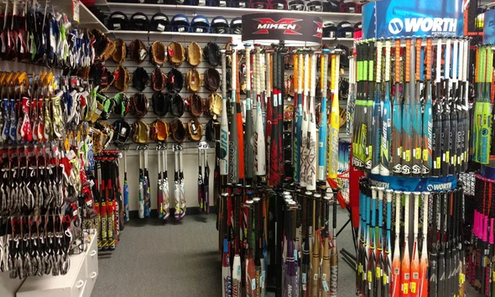

Slide 7
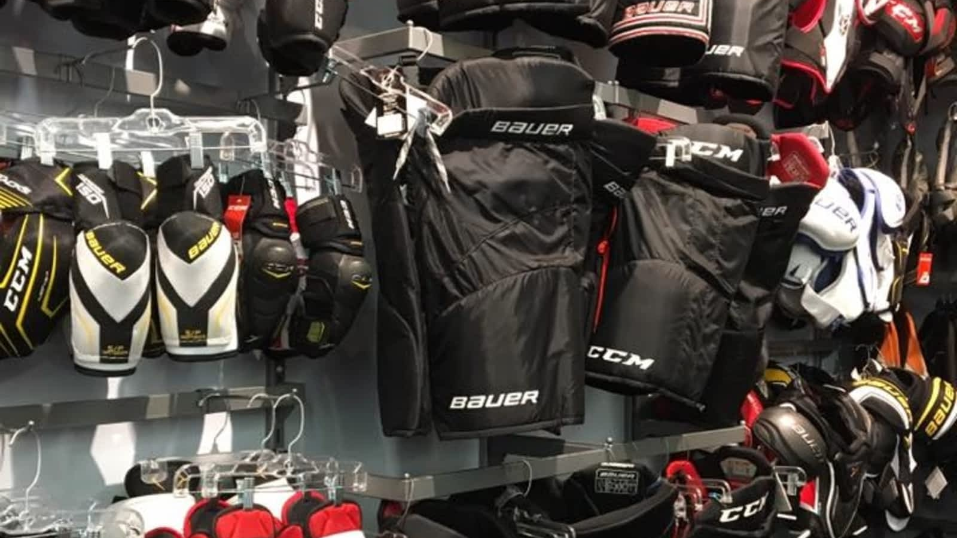

Slide 8
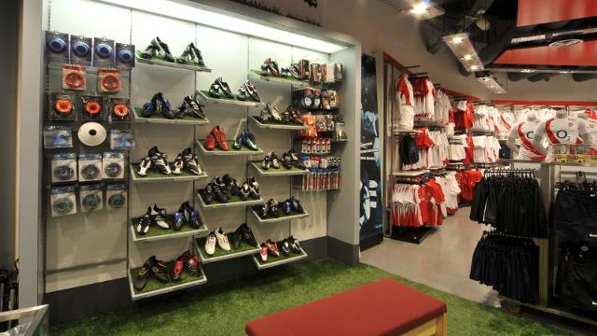

Slide 9
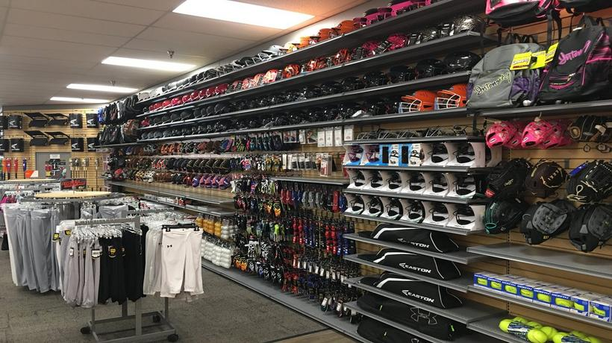

Slide 10


